Slide 1

ACTIVE
NOISE
CONTROL
WITHIN A CLASSROOM
Jalene Joyce
Dylan Mitchell Carson Pope
Caleb Turney
Jared Vega
This Photo by Unknown Author is licensed under CC BY-NC

Slide 2
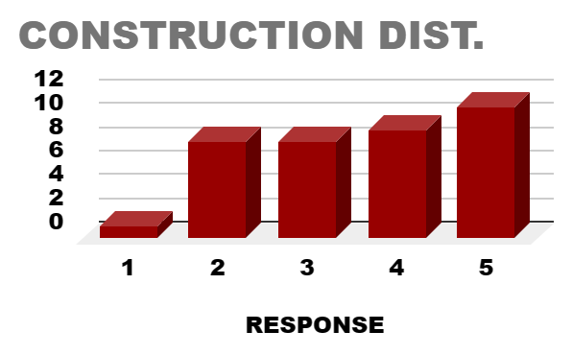
The Problem
Construction at Tennessee Tech has rapidly increased
This has created distractions in class due to the increased noise
An active noise control solution will improve the issue

Slide 3
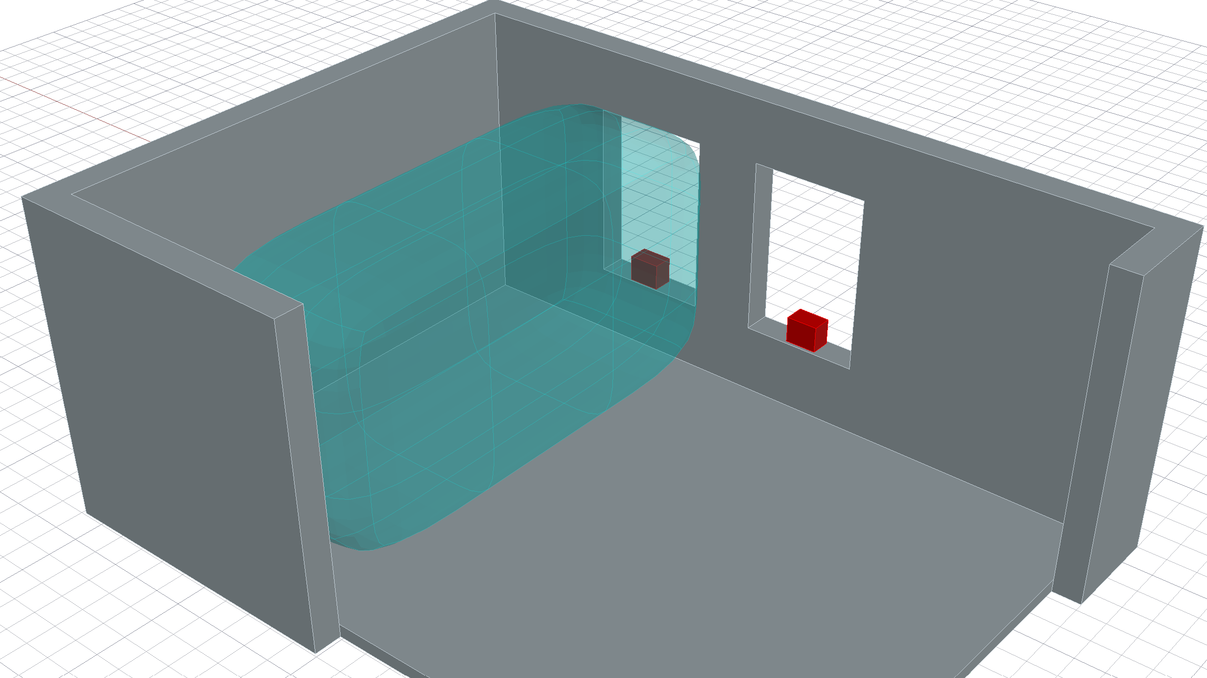
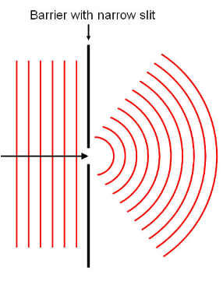
The Vision
The goal is to create an anti-noise system that cancels noise over a wide area of the room
The noise we want to cancel is the noise outside of the building

Slide 4
Standards and Regulation
Constraints
Regulations
Shall not record noise for longer than necessary (Privacy Concerns)
Shall not cancel in-room-produced sound (Stakeholders)
Shall not be a visible distraction (Stakeholders)
Shall not produce noises up to 80 dB for a long time (OSHA)
Minimize reduction of emergency alarms (OSHA)
Shall not obstruct accessible pathways (ADA)

Slide 5
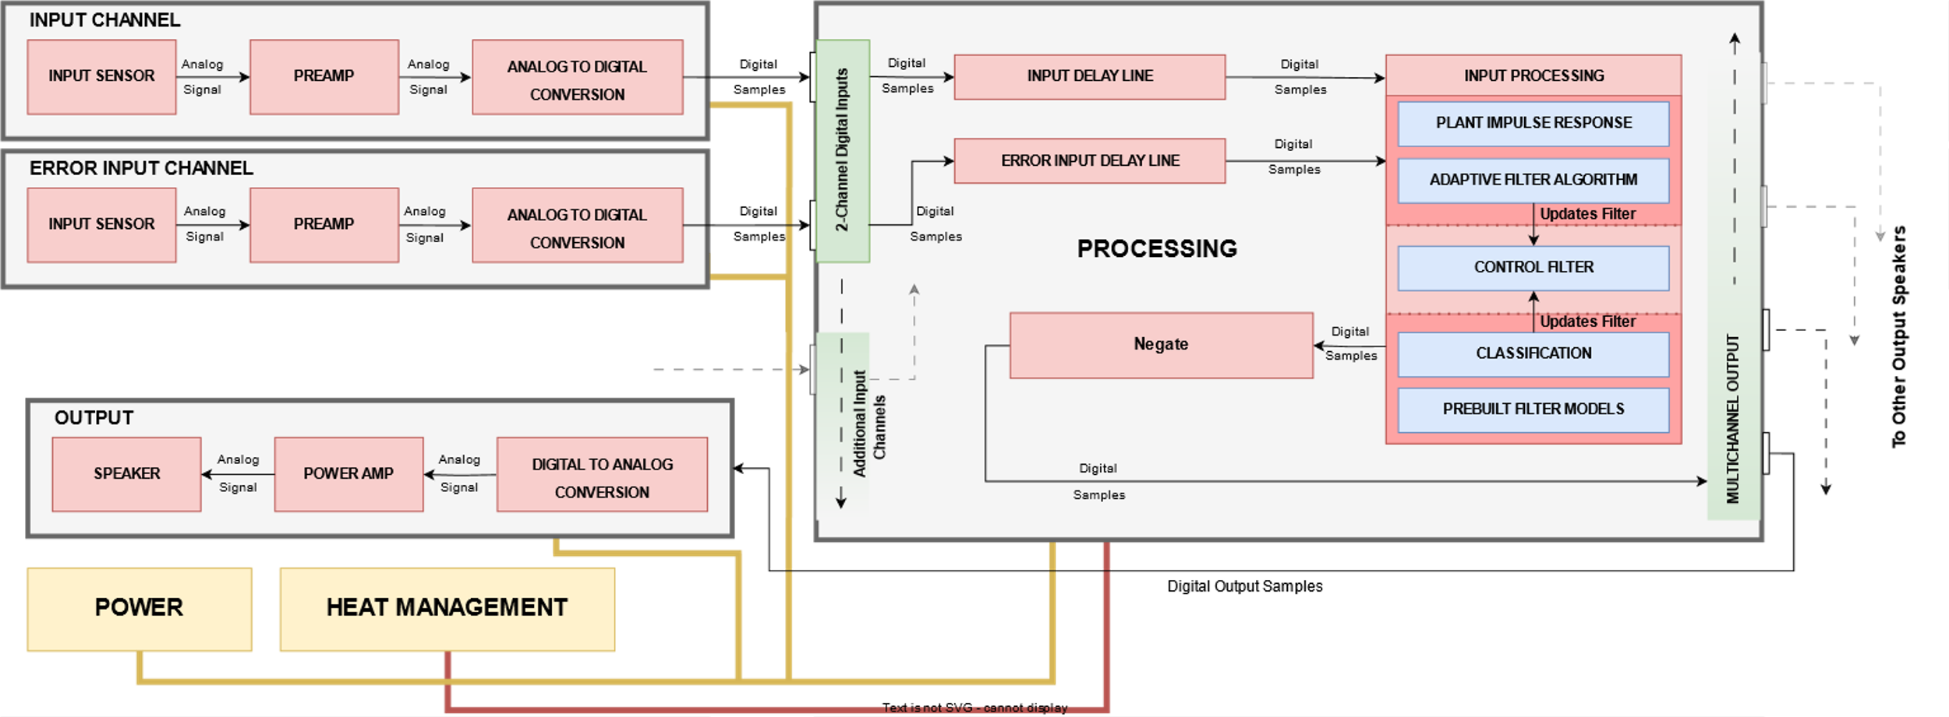

Slide 7
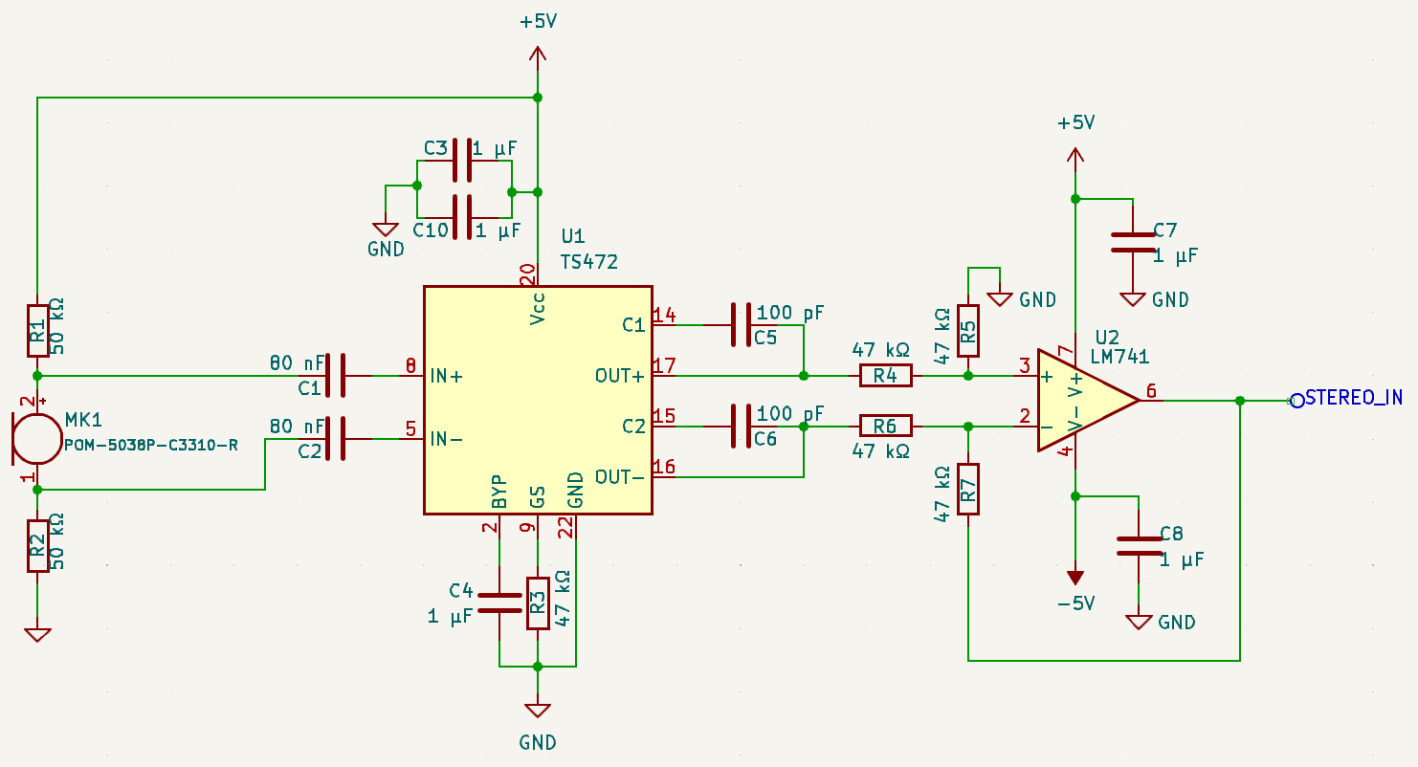
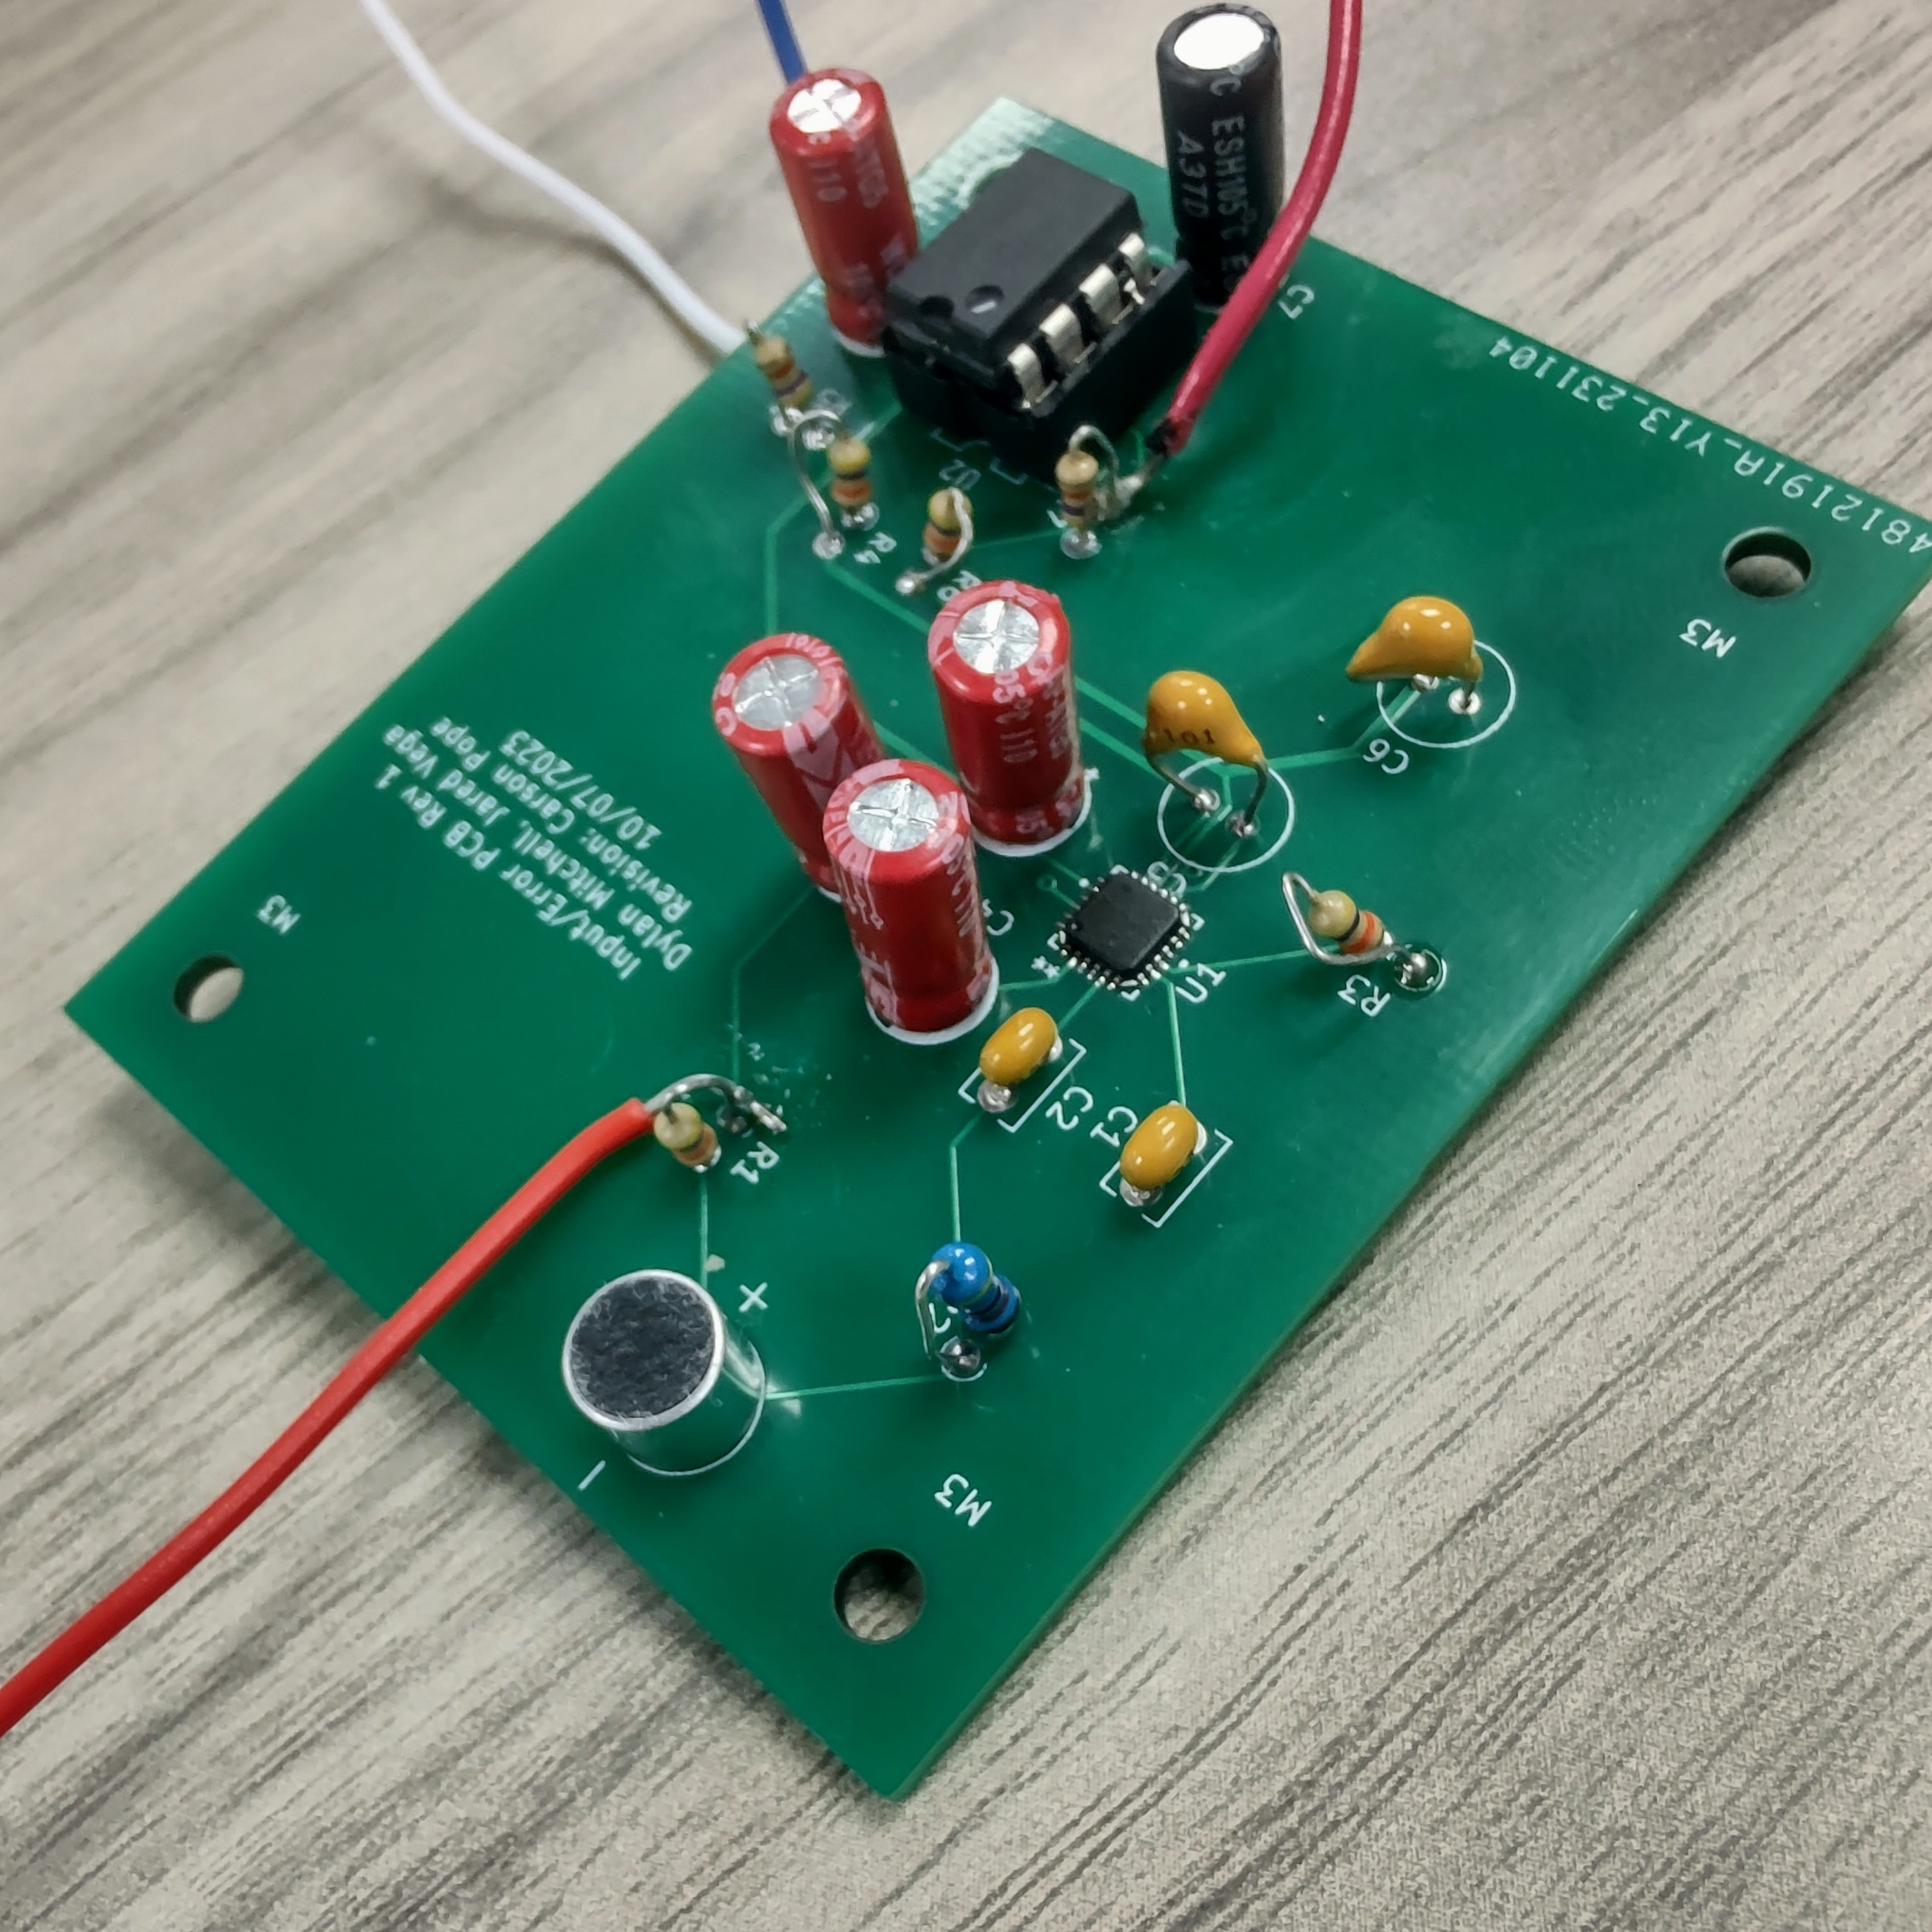
Input and Error
Same circuit was used for both input and error subsystems
Goal of Input is to receive noise from the window or wall
Goal of Error is to measure difference between output and input
Split into two halves: the preamplifier stage and the differential amplifier stage

Slide 10
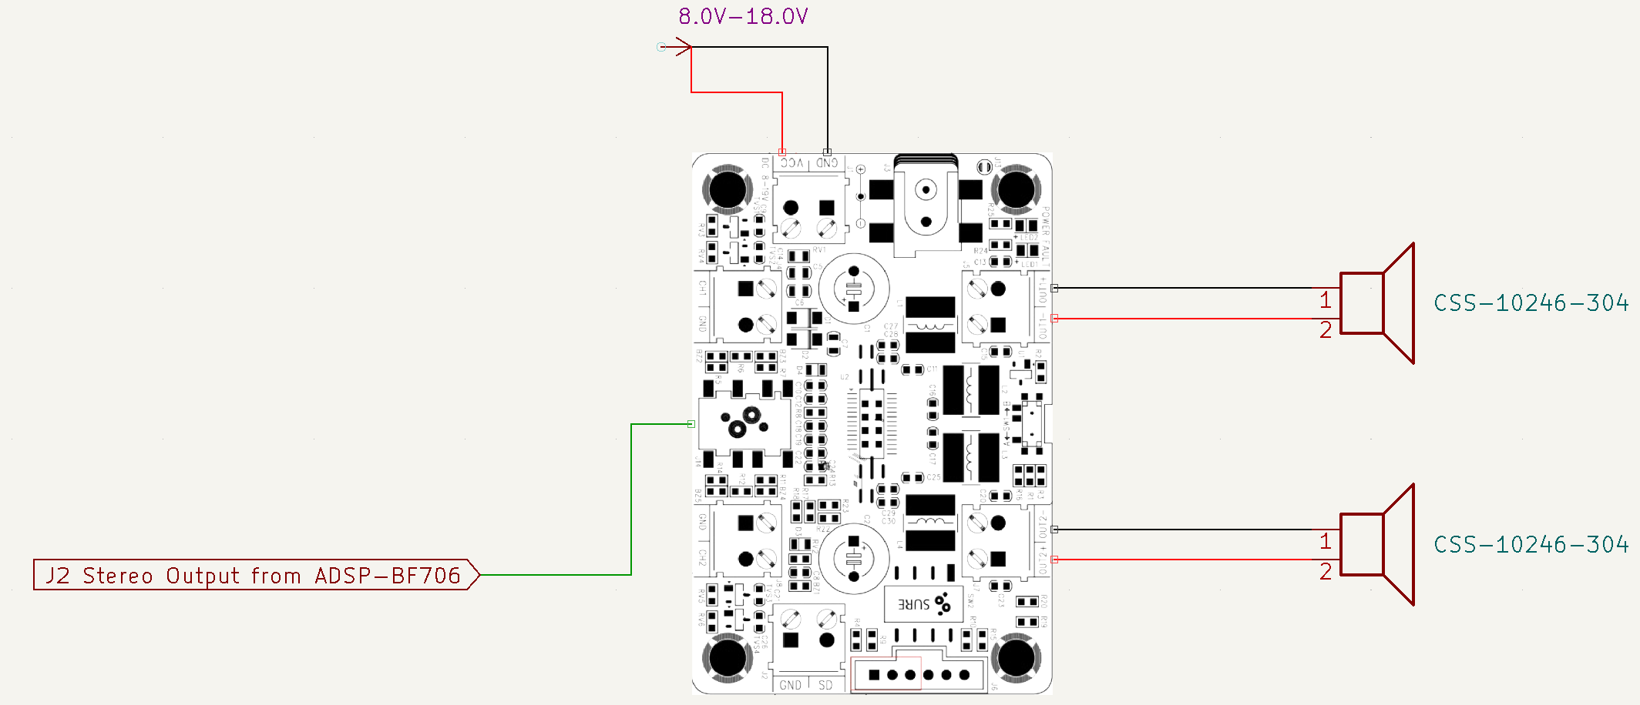
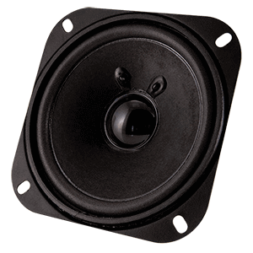
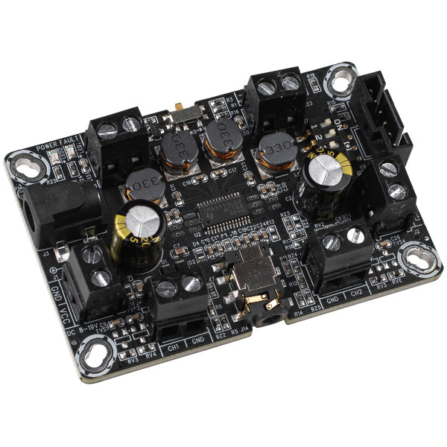
Output
Class-D Audio Amplifier AA-AB32231
CSS-10246-304 4Ω speaker
Amplifies and outputs processed signal

Slide 11
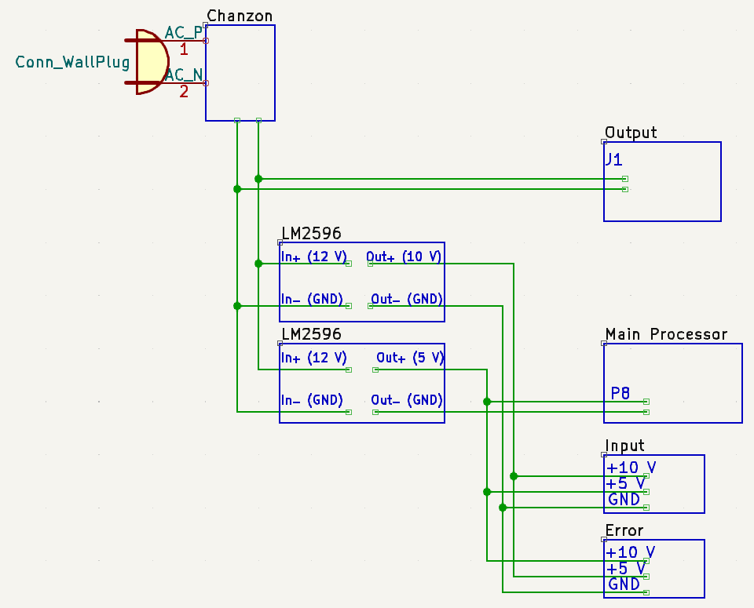
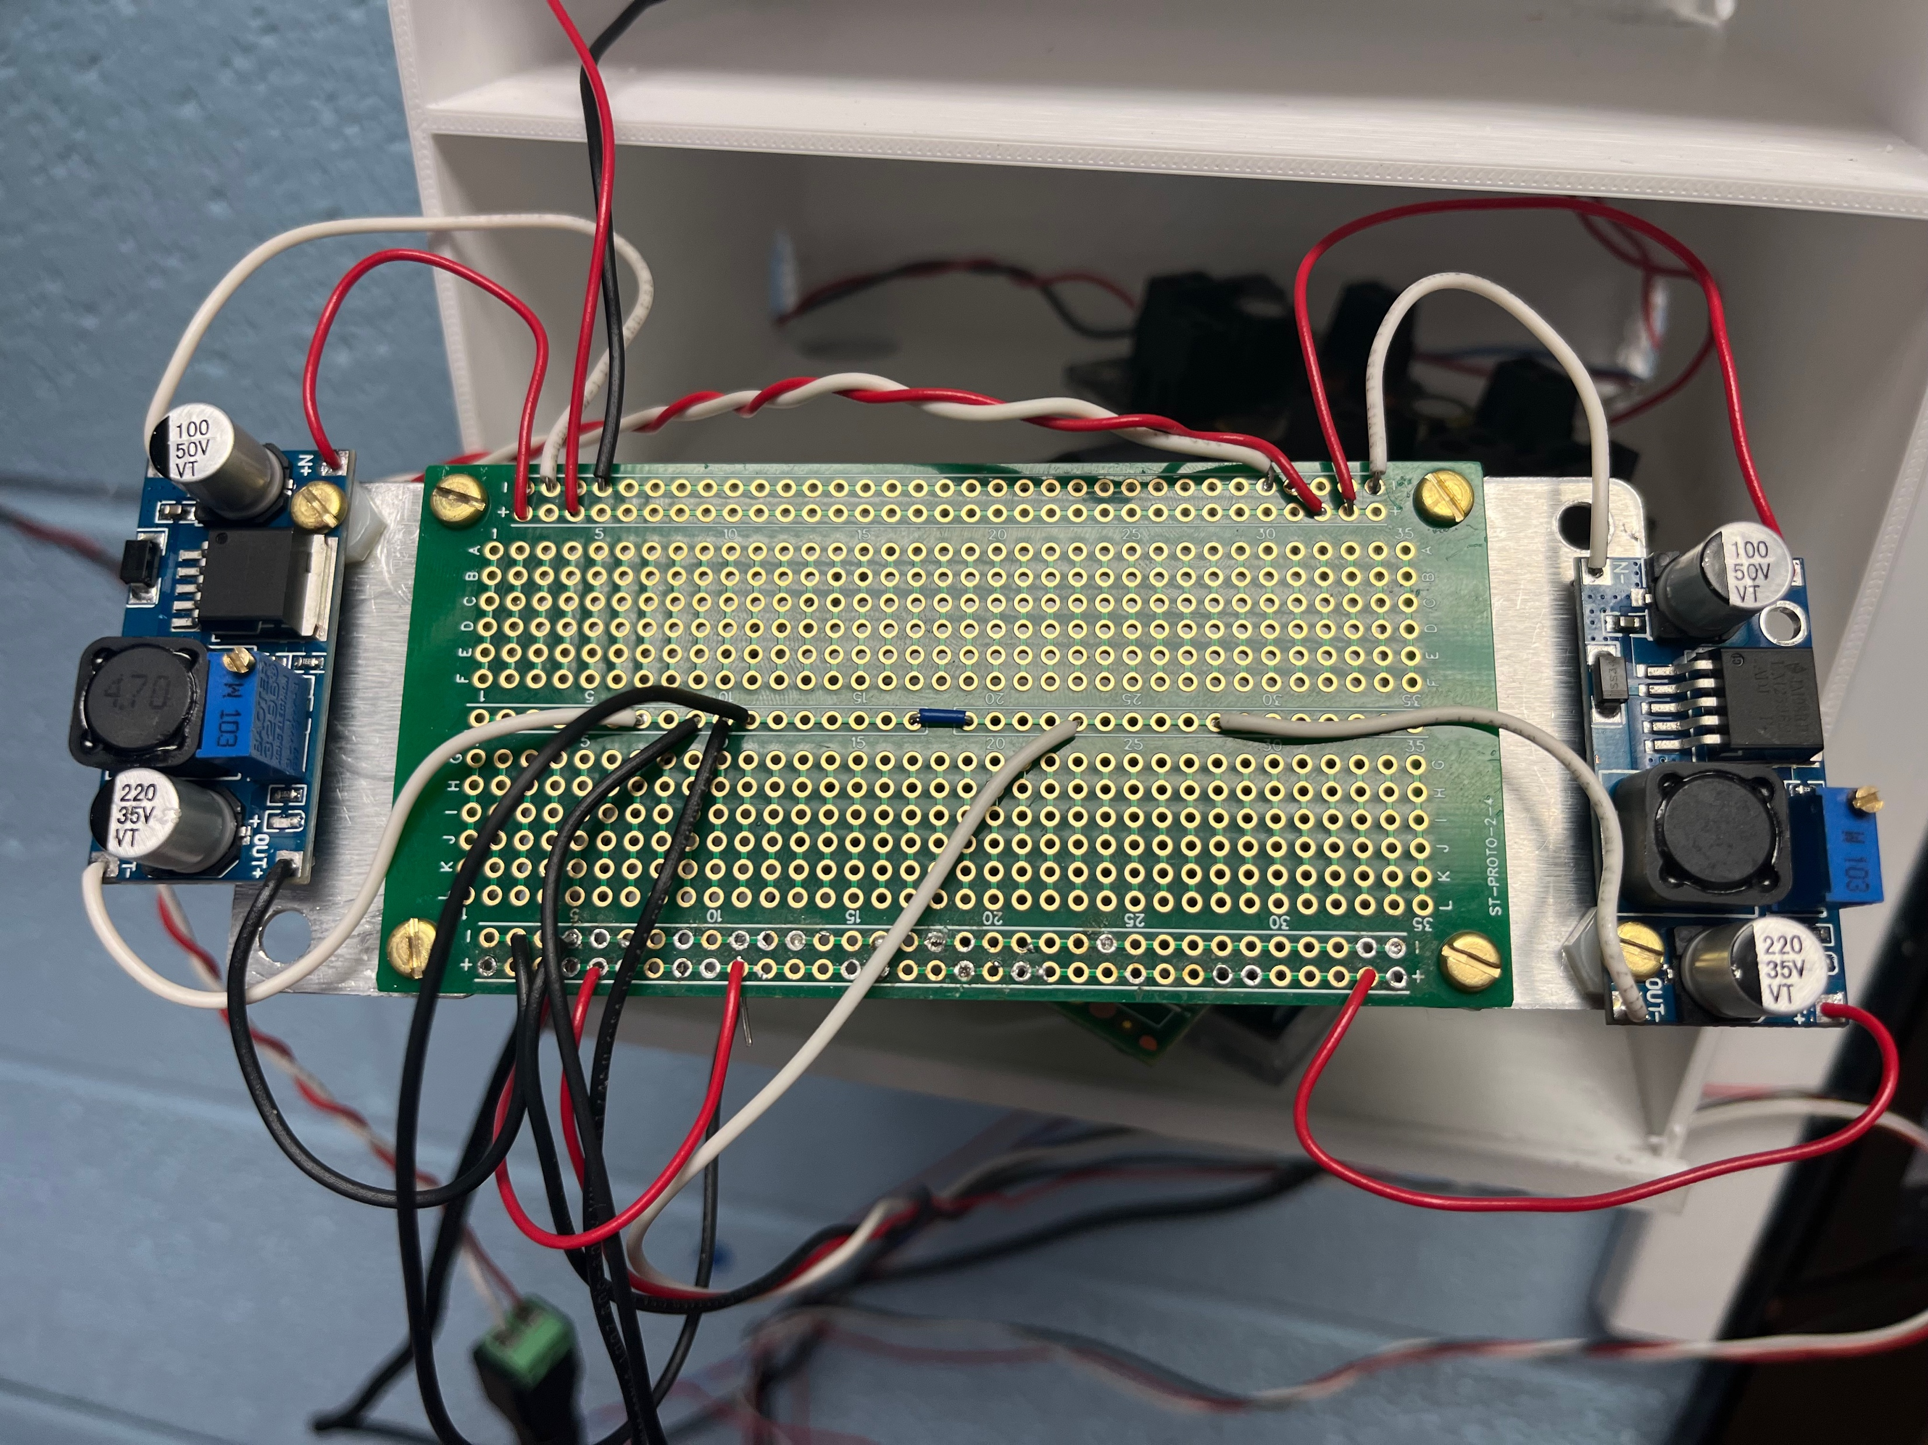
Power
Goal of the power subsystem was the following: provide 12V to the output, 10V to input and error, and 5V to Main processor
This was achieved by utilizing 2 buck converts, a proto-board, jumper cables, and a wall wart.
Wall wart provided 12V and 1.5A which was perfect to power the output subsystem
We utilized the buck converters to step down the voltages and power the input, output, and main processor.
The proto-board and jumper cables were used to bring everything together and efficiently power everything.

Slide 14
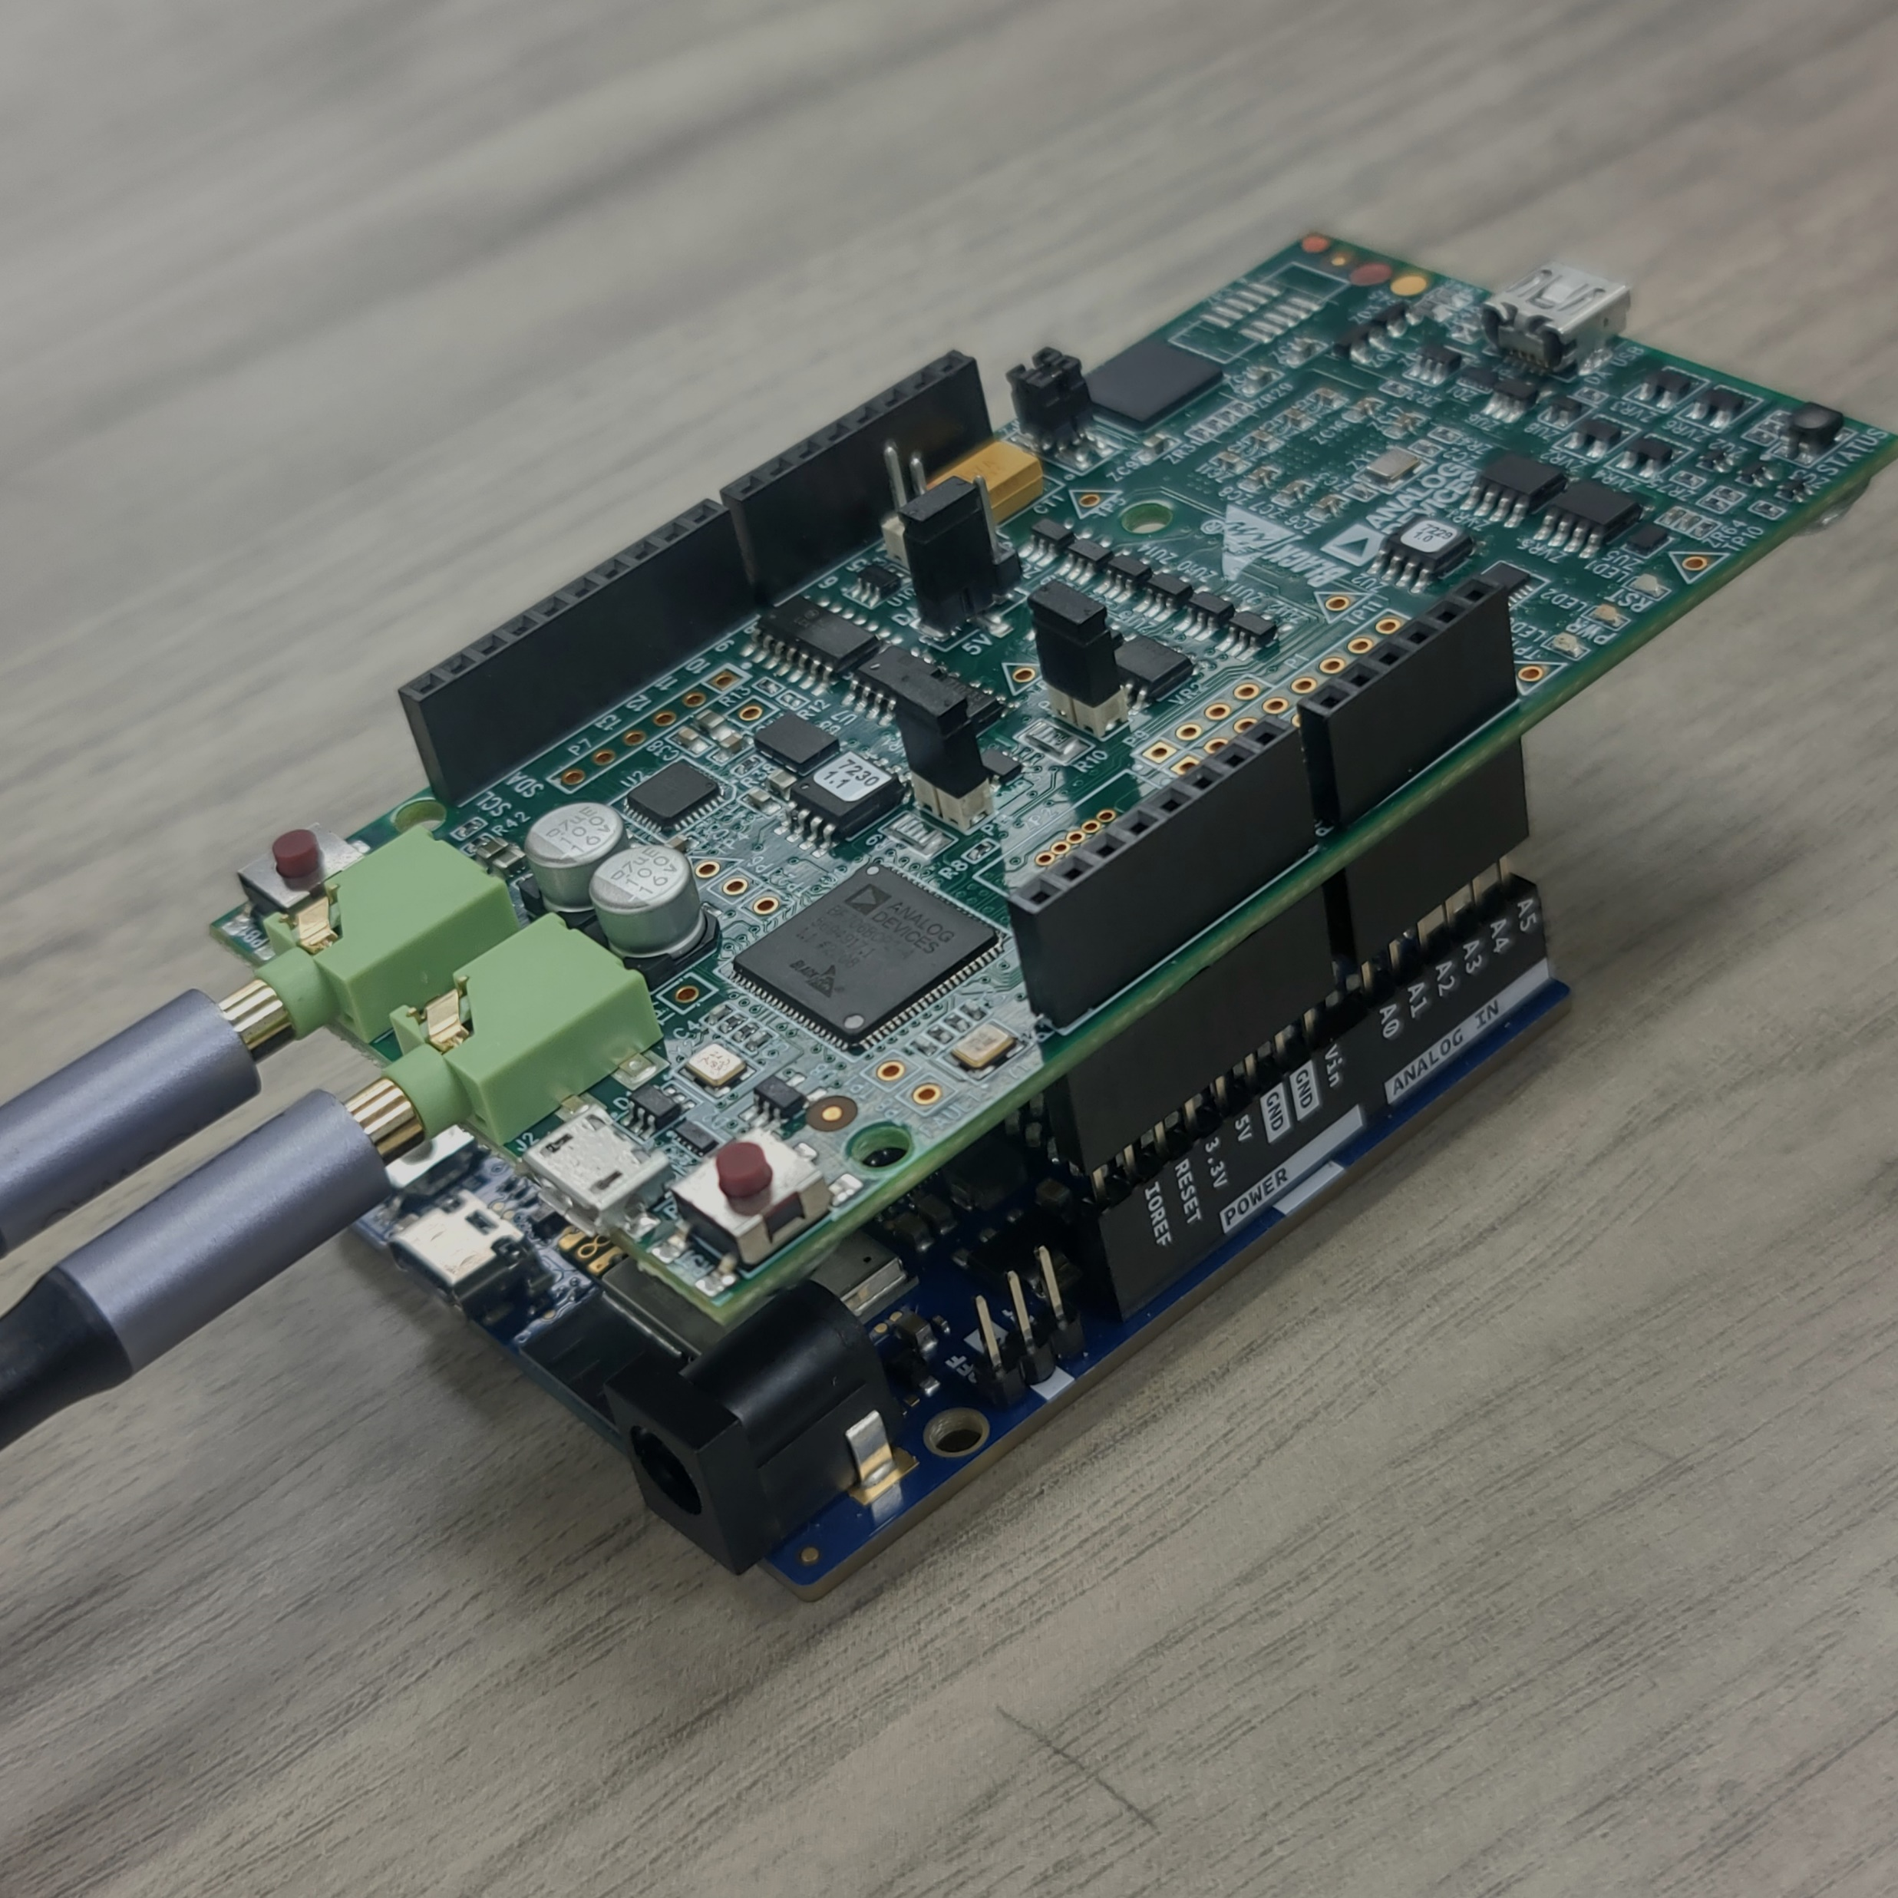
Main Processing Bluetooth Communications
EVAL-BF706M-EZLITE
24 Bit Audio Codec
64-Bit DSP Processor
Used for Quick Processing of FxLMS Algorithm
Bluetooth Communications
Arduino Uno R4 Wifi communicates with Arduino Nano 33 IoT

Slide 15
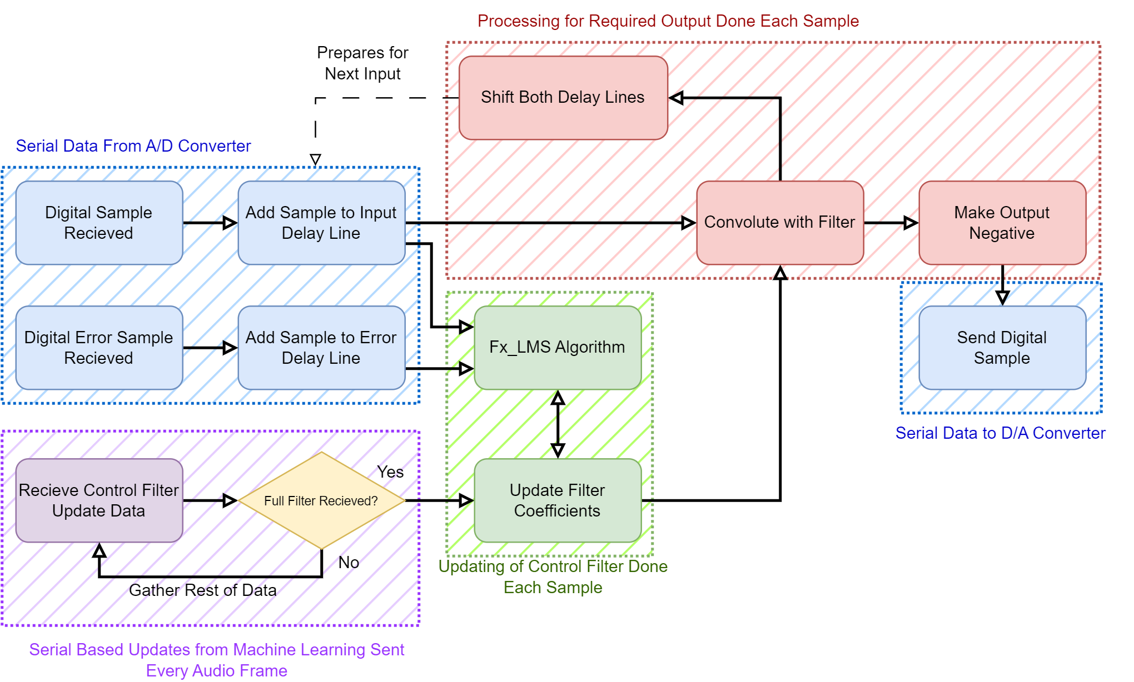
Software
Main System w/
Filtered X LMS
1D Convolutional Neural Network
Input Layer
Conv1D
Conv1D
MaxPooling1D
Dropout
Flatten
Dense
Dense

Slide 16
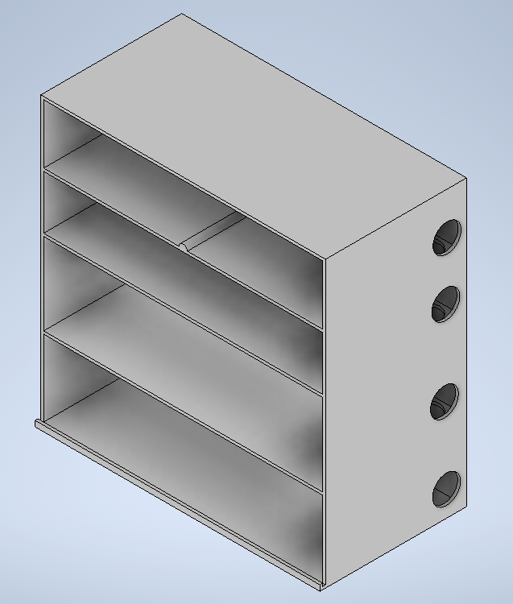
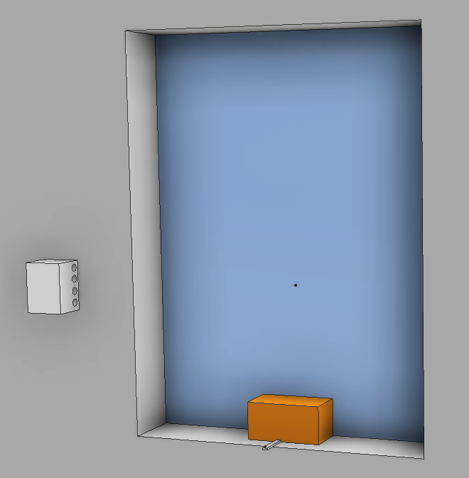
Mounting
A space to hold each subsystem
Mountable on the wall to minimize physical obstruction

Slide 17
Mistakes Were Made
Multiple Errors Occurred And Went Unnoticed Until The Implementation Phase
The Development Of Software For Transmitting Data On A Sample-by-sample Basis Between DSP And Arduino Posed Greater Challenges Than Initially Anticipated.
Forgot To Add I/O Ports On Input And Error PCB's
USB Connection Adaptors Were Not Ordered

Slide 18
Lessons Learned
Facilitating Communication Between Engineers Handling Distinct Subsystems Is Crucial
Double-check Every Aspect Of The Project To Minimize Errors
Documentation is Everything!

Slide 19
Budget
Subsystem | Cost
Main Processor | $135.8
Input | $5.43
Output | $32.35
Error | $5.43
Mounting | $14.83
Power | $26.07
Passives | $23.45
Total | $223.36

Slide 20
Experimental Setup
1. Setup a simulation of a classroom with outside noise coming in towards the input microphone and through to the speakers which point to the error microphone 2. Record ten-second audio clips using a microphone at the error location with ambient noise three times 3. Record ten-second audio clips using a microphone at the error location with generated noise without active noise cancellation three times 4. Record ten-second audio clips using a microphone at the error location with generated noise with active noise cancellation three times 5. Save all results, process data with MATLAB

Slide 21
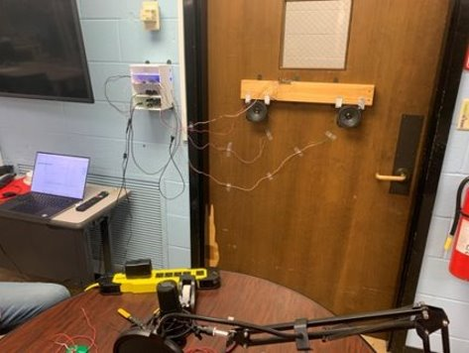

Demonstration
Without ANC
With ANC

Slide 22
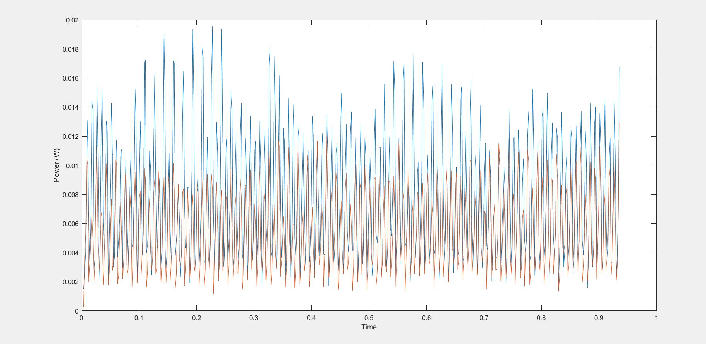
INSTANTANEOUS POWER VS TIME

Slide 23
Future Work
Incorporate Communication Between DSP and Machine Learning
Consolidate The Input, Output, And Power Subsystems Into A Unified PCB For Streamlined Functionality.
Make Sure To Double Check For Input/Output Ports!
Optimize The Algorithm For Active Noise Control To Enhance Performance.
Redesign Subsystems for Better Compatibility With Mounting

